Slide 1
ML Applications in Computer Vision
visual features extraction, features visualisation, model interpretation and model training and testing
Prepared By:
Kaniz Fatema Isha
Lecturer,
CSE KUET

Slide 2
Introduction
An image is a visual representation that can be in the form of photographs, graphics, or video frames. In digital terms, it is stored as a binary representation of visual data.
Images are composed of pixels, which are the smallest units of a digital image. Each pixel has a specific color and intensity
Color depth refers to the number of bits used to represent the color of a single pixel.

Slide 3
Introduction
A digital image is fundamentally composed of pixels, which are the smallest elements that make up the image.
Each pixel is characterized by its spatial coordinates within the image space and its intensity or gray level.

Slide 4
Introduction
A grayscale image consists of a single channel, where pixel values represent only intensity information. These values are typically integers ranging from 0 to 255, allowing for 256 discrete intensity levels.
RGB Images in contrast, an RGB image comprises three channels: Red, Green, and Blue.
Each pixel in an RGB image is represented by a triplet of intensity values corresponding to these three colors.
The RGB color model is widely used in computer vision applications due to its additive nature, where colors are created by mixing different light spectra.

Slide 5
Introduction

Slide 6
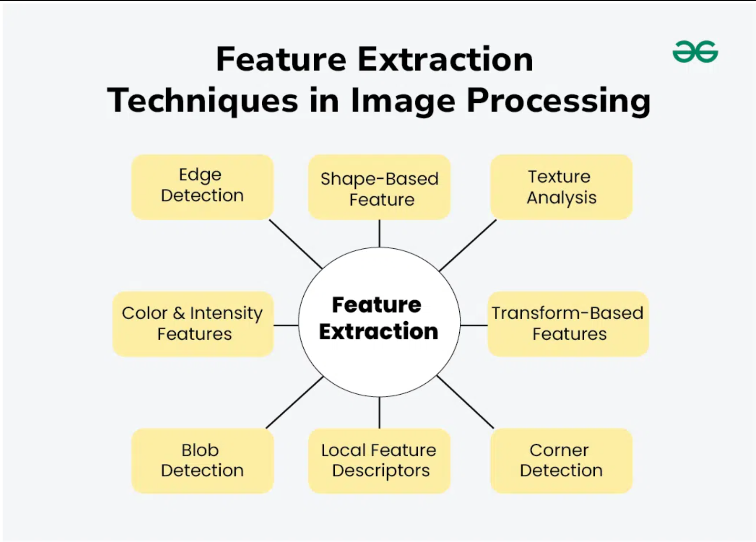

Slide 7
What is Edge and Corner
An edge is defined as a location in an image where there is a significant change in intensity or color.
A corner is defined as a point where two edges meet, characterized by a significant change in direction. It can also be described as a point with two dominant edge directions in its local neighborhood

Slide 8
Image Convolution Filtering
Convolution is a fundamental operation in image processing that involves applying a mathematical kernel (or filter) to an input image to produce an output image.
This process is essential for various image manipulation tasks, including blurring, sharpening, and edge detection.
To achieve different results, we must use different kernels or masks.
For further clarification, check out the article [1].

Slide 9
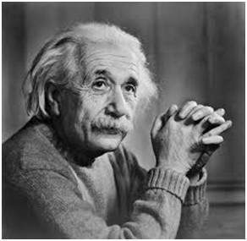
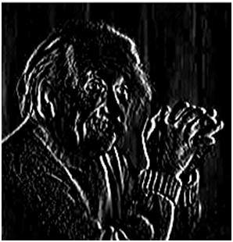
Image Convolution Filtering

Slide 10
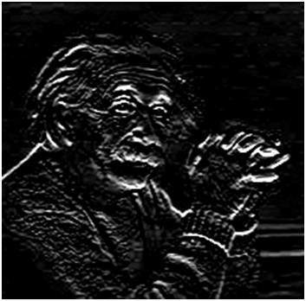
Image Convolution Filtering

Slide 11
Canny Edge Detection
The Canny Edge Detection algorithm is a popular technique in computer vision for identifying edges in images.

Slide 12
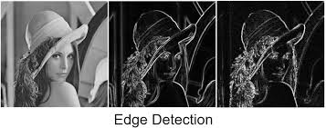

Slide 13
Canny Edge Detection
The Canny edge detection algorithm comprises several key steps:
Noise Reduction: The image is smoothed using a Gaussian filter to minimize noise.
Gradient Calculation: The intensity gradients are computed using Sobel filters.
Non-Maximum Suppression: This step thins out the edges by keeping only local maxima in the gradient image.
Double Thresholding: Strong and weak edges are identified based on the two thresholds provided.
Edge Tracking by Hysteresis: Weak edges connected to strong edges are retained, while others are discarded.

Slide 14
Harris Corner Detection
The Harris Corner Detection algorithm is a popular technique in computer vision for identifying corners in images.

Slide 15
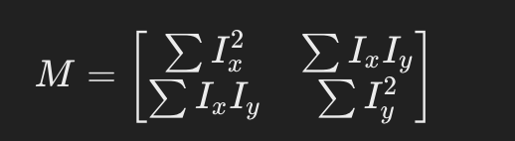
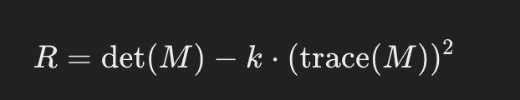
Harris Corner Detection
Key steps Steps of the Algorithm
Convert to Grayscale: The input image is transformed into a grayscale format to simplify processing.
Compute Image Derivatives: The algorithm calculates the spatial derivatives (gradients) using convolution with Sobel operators.
Construct Structure Tensor: The structure tensor is formed from the products of these derivatives, which helps in evaluating the intensity variations in different directions.
Calculate Harris Response: A response function is computed from the structure tensor, which scores each pixel based on its likelihood of being a corner. High response values indicate corners.

Slide 16
Harris Corner Detection
The cv2.cornerharris() function in OpenCV is used to detect corners in an image based on the Harris Corner Detection algorithm.
It computes a "corner response" matrix that highlights the strength of corner-like features in an image.
Format: cv2.cornerHarris(src, blockSize, ksize, k).
Here, k is Harris detector free parameter, typically in the range [0.04, 0.06].It determines the sensitivity of corner detection
This function returns a 2D array of input size where each value represents the corner strength (response) at that pixel.

Slide 17
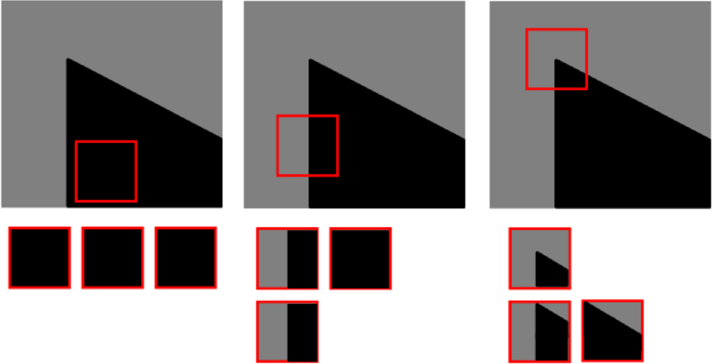
Corner Detection

Slide 18
Understanding LIME: Local Interpretable Model-agnostic Explanations
Developed by Marco Ribeiro in 2016, it provides a method to explain predictions made by machine learning models.
Key Features of LIME includes:
Model Agnostic: Works with any machine learning model, regardless of its architecture.
Local: Focuses on explaining predictions for individual instances rather than the entire model.

Slide 19
Understanding LIME: How LIME Works
Select Model and Reference Point: Choose the machine learning model and a specific instance to explain.
Generate Data Points: Create synthetic data points around the reference point using a normal distribution.
Predict Outcomes: Use the original model to predict outcomes for these synthetic points.
Weight Points: Assign weights to these points based on their proximity to the reference point using a Gaussian (RBF) Kernel.
Train Surrogate Model: Fit a simple, interpretable model (like Linear Regression) to these weighted points to approximate the original model locally.

Slide 20
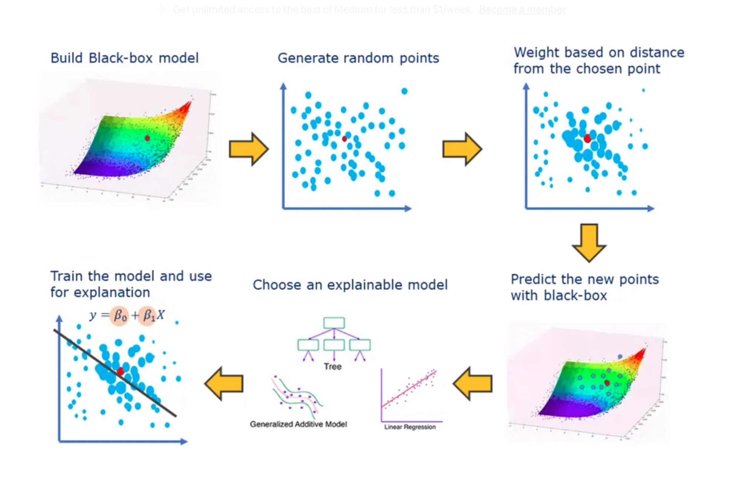
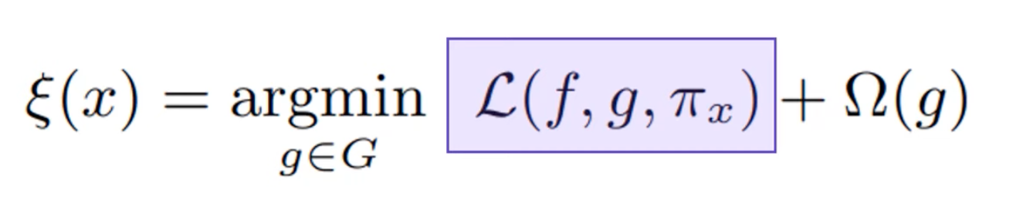

Slide 21
Understanding LIME: Limitations of LIME
Instability: The explanations can vary depending on how perturbed samples are generated or how kernel widths are chosen.
Local Validity Only: Explanations are valid only in the vicinity of the selected instance and may not generalize globally.
Complexity Choices: The user must carefully select parameters like kernel width and surrogate model complexity, which can influence results significantly.

Slide 22
GradCAM: Gradient-weighted Class Activation Mapping
Grad-CAM is a powerful technique that provides visual explanations for the predictions made by convolutional neural networks (CNNs).
Grad-CAM is an explainability method that highlights the regions of an image that contribute most to a model's classification decision.
It operates by utilizing the gradients of the output class score with respect to the feature maps from the final convolutional layer of a CNN.
This allows Grad-CAM to visualize which parts of an image are most influential in the model's decision-making process.

Slide 23
GradCAM: Gradient-weighted Class Activation Mapping
Compute Gradients: Find out how much the model's prediction changes when each feature map (a layer of processed image data) changes. This tells us which feature maps are most important for the prediction.
Calculate Weights: Average the importance of each feature map across its entire area (using global average pooling). These averages become the "weights" that show how much each feature map contributes to the prediction.
Create Heatmap: Combine the feature maps using their weights, and keep only the positive values (using a ReLU function). This creates a heatmap that highlights the important regions of the image for the prediction.
Overlay Heatmap: Place the heatmap on top of the original image to visually show which parts of the image influenced the model's decision.

Slide 24
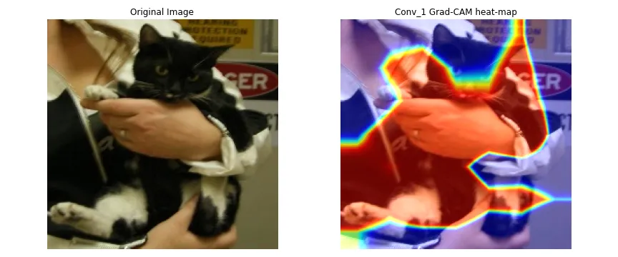
GradCAM: Gradient-weighted Class Activation Mapping

Slide 25
Model Training and Testing
Before training a model, it is essential to divide the dataset into two main subsets: the training set and the test set.
The training set is used to train the model, while the test set evaluates its performance on unseen data.
Train-Test Split: A common approach is to split the dataset into 70-80% for training and 20-30% for testing.
Cross-Validation: This technique involves dividing the dataset into multiple subsets (folds) and training/testing the model several times to ensure robustness.Example: k-fold

Slide 26
Model Training and Testing
Data preprocessing is critical for improving model performance. Common preprocessing steps include:
Resizing: Adjusting image dimensions to match the input size required by the model.
Normalization: Scaling pixel values (e.g., from 0-255 to 0-1) to ensure uniformity and improve convergence during training.
Augmentation: Applying transformations (e.g., rotation, flipping, zooming) to increase dataset diversity and reduce overfitting.

Slide 27
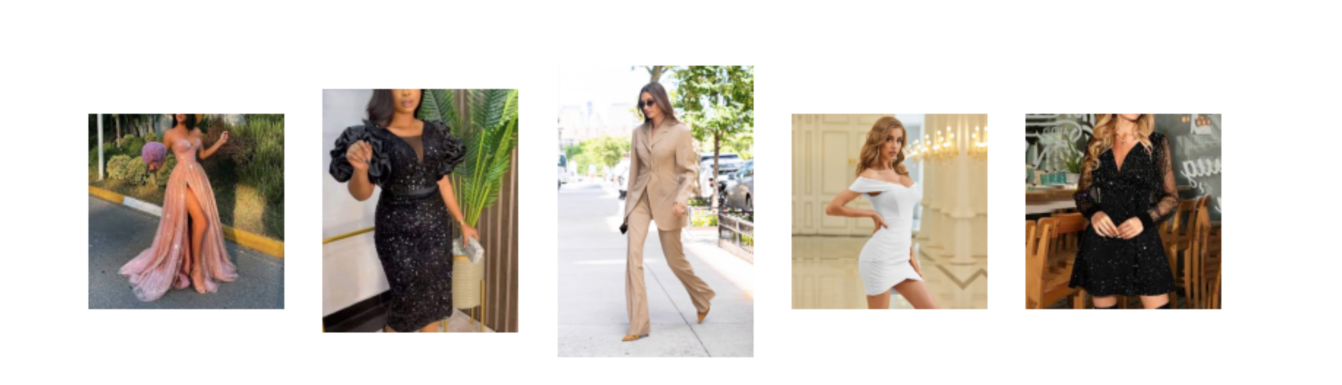
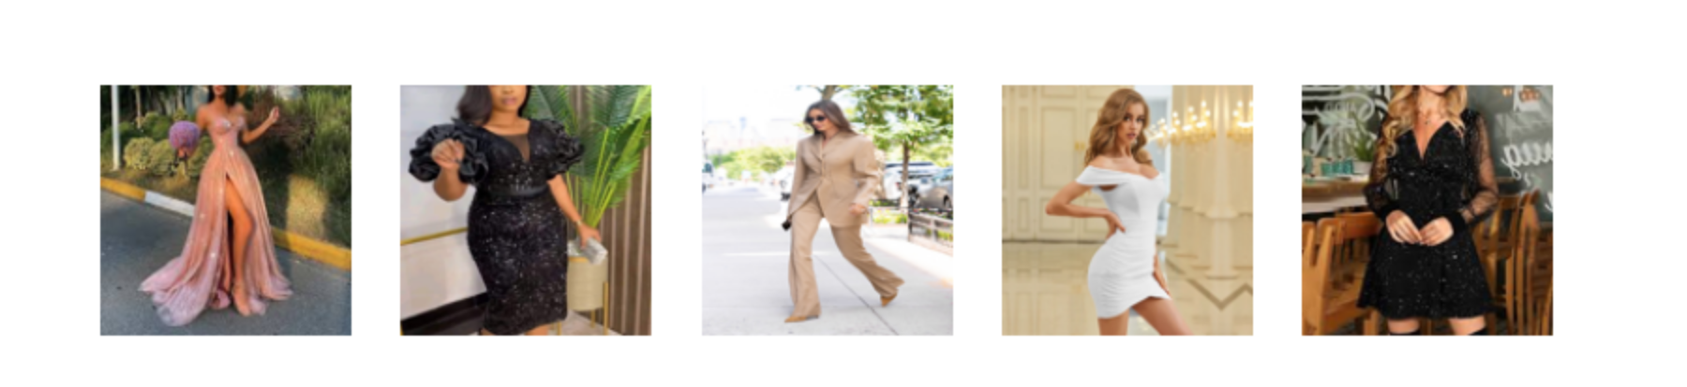

Slide 28
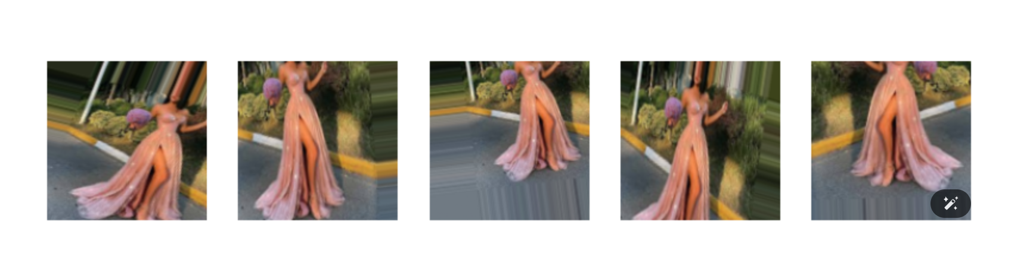

Slide 29
Model Training and Testing
Accuracy: The ratio of correctly predicted instances to total instances.
Precision: The ratio of true positive predictions to the sum of true positives and false positives. It measures how many selected items are relevant.
Recall: The ratio of true positive predictions to the sum of true positives and false negatives. It measures how many relevant items are selected.
F1-score: The harmonic mean of precision and recall, providing a balance between them.

Slide 30
Reference
https://machinelearningmastery.com/opencv_edges_and_corners/
https://machinelearningmastery.com/how-to-read-write-display-images-in-opencv-and-converting-color-spaces/
https://www.geeksforgeeks.org/feature-extraction-in-image-processing-techniques-and-applications/
https://machinelearningmastery.com/opencv_edges_and_corners/
https://medium.com/@deepanshut041/introduction-to-harris-corner-detector-32a88850b3f6
https://medium.com/@divakar1591/grad-cam-gradient-weighted-class-activation-mapping-8e1aeaf96d94
https://towardsdatascience.com/understand-your-algorithm-with-grad-cam-d3b62fce353

Slide 31
Reference
https://towardsdatascience.com/lime-explain-machine-learning-predictions-af8f18189bfe
https://medium.com/@timothy_terati/image-convolution-filtering-a54dce7c786b#:~:text=In%20image%20convolution%2C%20involves%20a,that%20of%20the%20input%20image's.[1]
https://www.kaggle.com/code/rimmelasghar/getting-started-with-image-preprocessing-in-python

